Slide 1
Movie Recommendation System Using Python
Group Members:
1)Aditya Yadav(20103063)
2) Hardik Bahri(20103088)
3) Ojus Chugh(20104046)
3) Kartik Kapoor(20103083)
4) Ishaan Verma(20103086)

Slide 2
Introduction
The purpose of the project is to suggest movies to the user based on his/her preferences. The program asks for the names of favorite movies of the user and outputs a list of movies that have a high probability of being enjoyable to the user.
The programming language used is Python. Jupyter notebook is used to execute the program.
An existing dataset of movies from Kaggle is used by the program.

Slide 3
Libraries Used
Numpy to work with arrays
Pandas to create dataframes of the dataset
Difflib to get closely matching terms to any given term
Sklearn.feature_extraction.text for TfidfVectorizer
Sklearn.metrics.pairwise for cosine_similarity

Slide 4
Pre Processing the dataset
We only take into consideration the relevant attributes of each movie.
They are, selected_features = ['genres','keywords','tagline','cast','director‘]
We replace the null values with null string.
for feature in selected_features:
movies_data[feature] = movies_data[feature].fillna('')

Slide 5
Tf idf Vectoriser
Convert a collection of raw documents to a matrix of TF-IDF features.
Provides fit_transform(raw_documents, y=None) function.
Learn vocabulary and idf, return document-term matrix.
Returns X, sparse matrix of (n_samples, n_features)

Slide 6
Cosine Similarity
Compute cosine similarity between samples in X and Y.
Cosine similarity, or the cosine kernel, computes similarity as the normalized dot product of X and Y:
Returns a 2D grid which depicts similarity of every document with every other document.

Slide 7
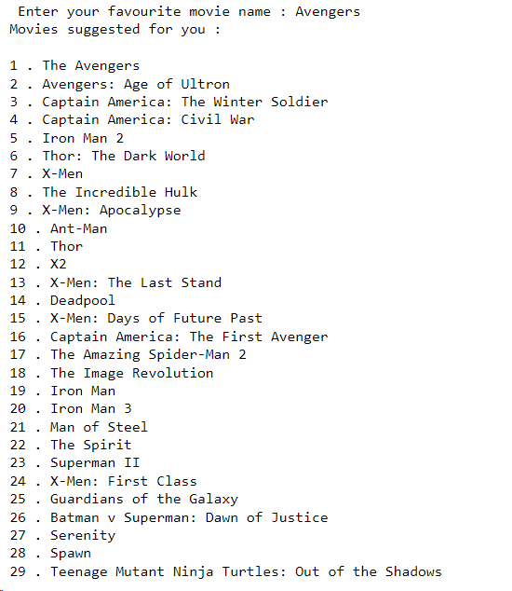
Result

Slide 8
Thank You

